Slide 1


Heart Disease Prediction
Using Machine Learning to Predict Heart Disease
Sree Sravya Tumuluri
DS5220
Prof Dr. Fatema Nafa

Slide 2
Introduction
Project Objective: Develop a classification model to predict the presence of heart disease based on various health metrics and patient demographics.
Significance: Heart disease is a leading cause of mortality worldwide. Accurate prediction can improve patient outcomes and reduce healthcare costs.
Personal Interest: Combines my passion for healthcare and technology.

Slide 3
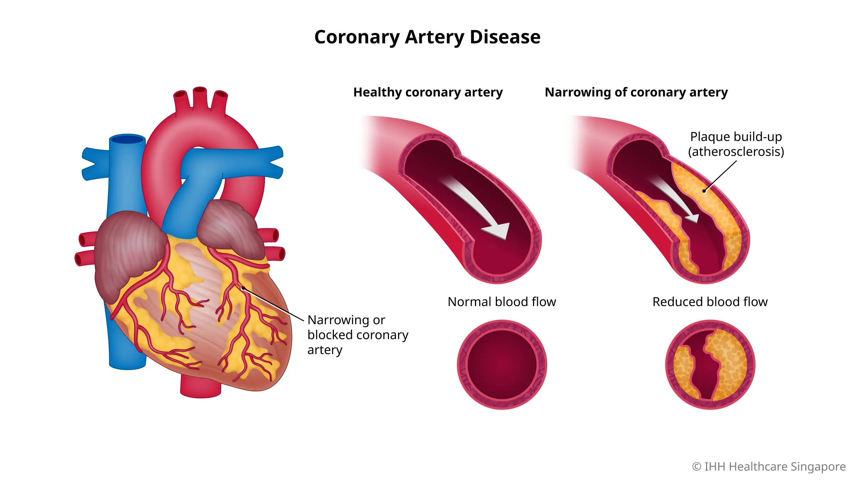
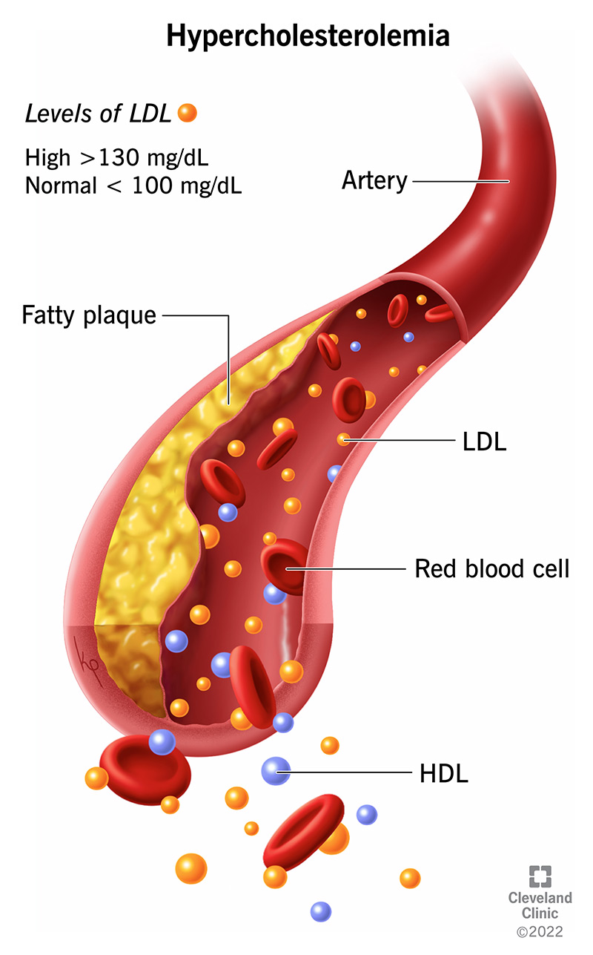
Literature Review Heart Diseases
Coronary Artery Disease (CAD)
Cause: Plaque buildup in arteries
Impact: Reduced blood flow, chest pain, heart attacks
Hypertension (High Blood Pressure)
Cause: Persistent high blood pressure
Impact: Heart strain, increased risk of heart attack and stroke
Hypercholesterolemia (High Cholesterol)
Cause: High cholesterol levels
Impact: Plaque in arteries, CAD, heart attack, stroke
Arrhythmia
Cause: Irregular heartbeat
Impact: Inefficient blood pumping, stroke, heart failure

Slide 4

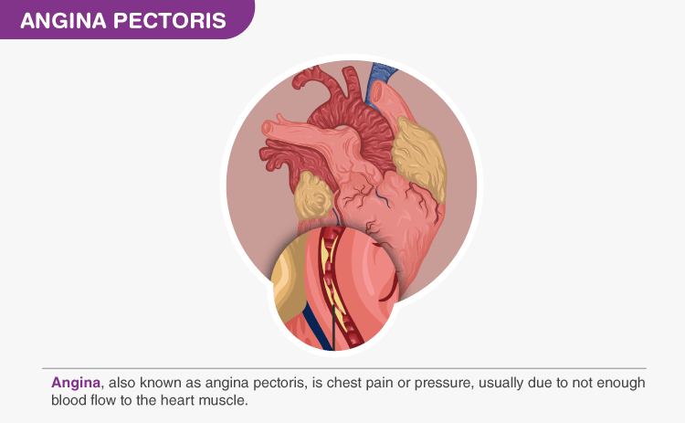
Heart Disease (contd.)
Ischemic Heart Disease (IHD)
Cause: Reduced blood supply to heart muscle
Impact: Chest pain, heart attacks, heart failure
Angina Pectoris
Cause: Reduced blood flow to heart muscle
Impact: Chest pain during activity, risk of heart attack
Thalassemia-Related Cardiac Issues
Cause: Genetic blood disorder
Impact: Heart enlargement, heart failure due to severe anemia

Slide 5

Dataset Overview
Heart Disease UCI Dataset:
Attributes: Age, sex, chest pain type, resting blood pressure, serum cholesterol, fasting blood sugar, resting electrocardiographic results, maximum heart rate achieved, exercise-induced angina, ST depression induced by exercise, slope of peak exercise ST segment, number of major vessels, categorical variable for heart disease presence.
Cardiovascular Disease Dataset:
Attributes: Age, gender, height, weight, blood pressure, cholesterol, glucose, smoking, alcohol intake, physical activity, presence of cardiovascular disease.
Size: 70,000 records of patients.

Slide 6
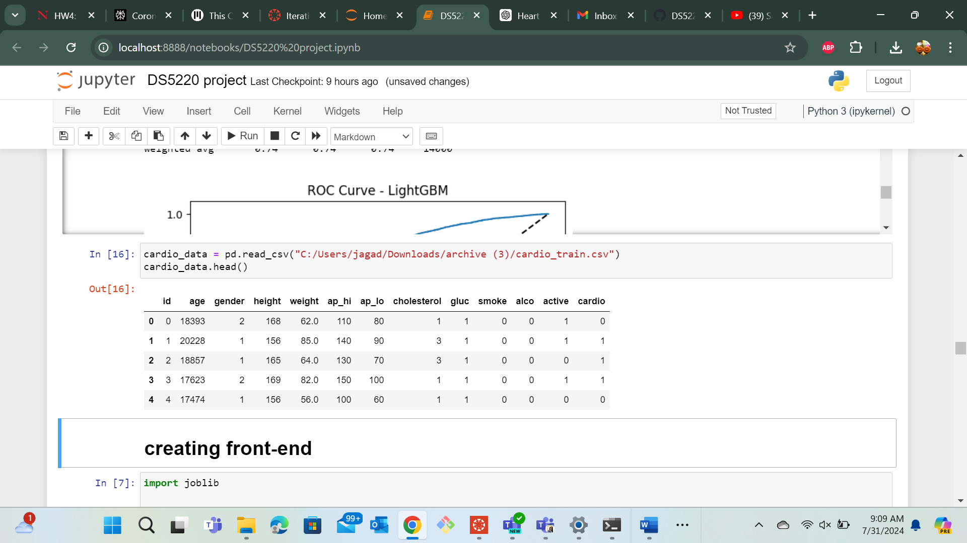
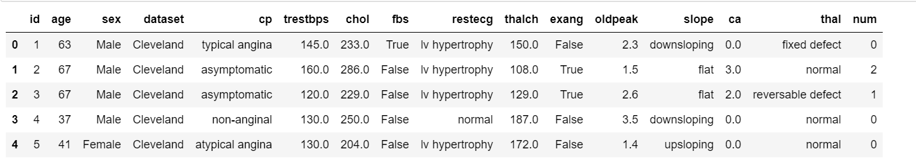

Slide 7
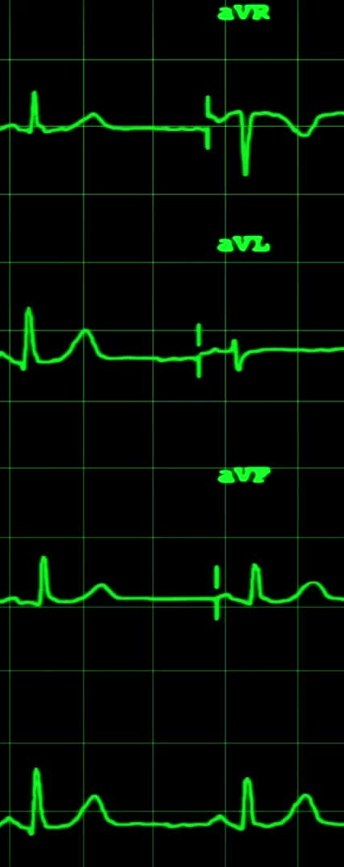
Methodology
Data Collection: Utilize the Heart Disease UCI and Cardiovascular Disease datasets.
Data Preprocessing: Handle missing values, normalize/standardize data, encode categorical variables.
Feature Engineering: Create new features from existing data, select important features.
Model Selection: Choose various classification algorithms (e.g., Logistic Regression, Decision Trees, Random Forest, SVM, Neural Networks).
Model Training: Split data into training and test sets, train models using cross-validation.
Model Evaluation: Evaluate models using accuracy, precision, recall, F1-score, ROC-AUC.

Slide 8
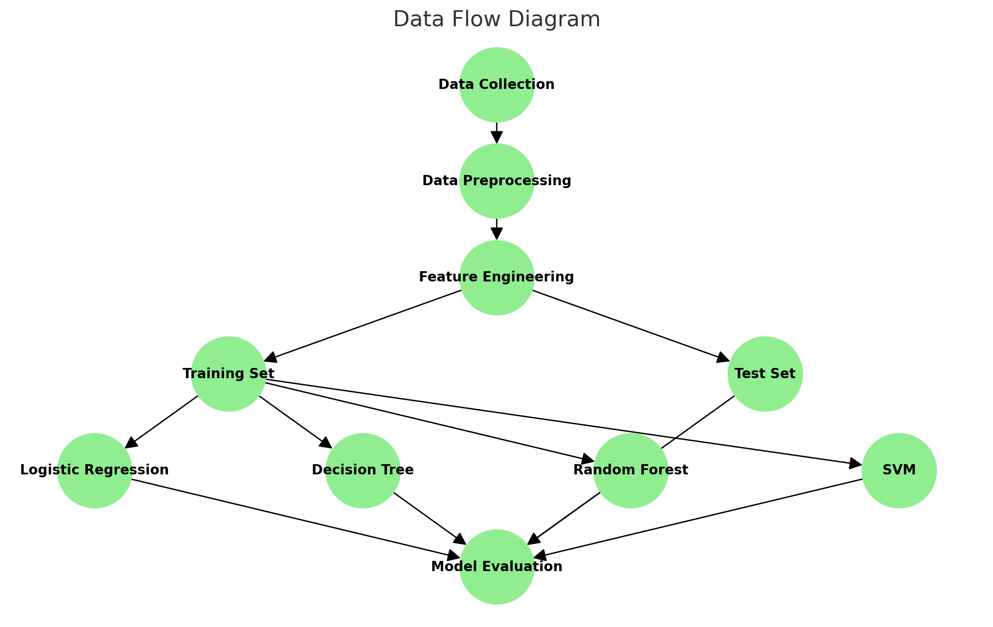
Data flow diagram

Slide 9
Data Preprocessing
Handling Missing Values: Impute missing values using methods like mean/mode/median imputation or more sophisticated techniques like KNN imputation.
Normalization/Standardization: Scale features to a standard range using techniques like MinMaxScaler or StandardScaler.
Encoding Categorical Variables: Convert categorical variables to numerical values using one-hot encoding or label encoding.

Slide 10
Feature Engineering
Creating New Features: Derive new features from existing data, such as BMI from height and weight, or age groups.
Feature Selection: Use techniques like correlation matrix, Recursive Feature Elimination (RFE), or feature importance from tree-based models to select relevant features.

Slide 11
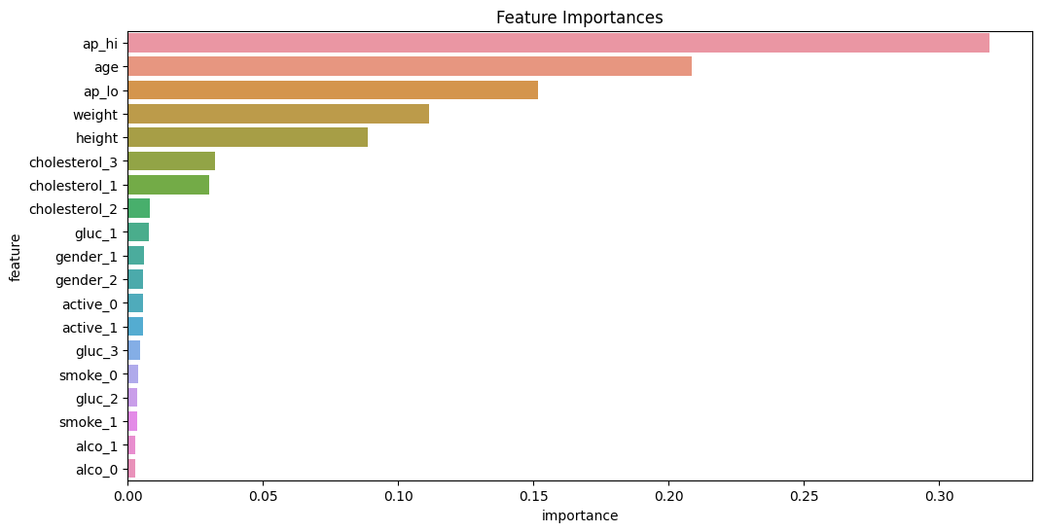

Slide 12

Model Selection
Logistic Regression
Advantages: Easy to implement and interpret, works well for linearly separable data, provides probabilities for predictions.
Decision Trees
Advantages: Easy to visualize and understand, can handle both numerical and categorical data, no need for feature scaling.
Random Forest
Advantages: Reduces overfitting, handles missing values well, works well with large datasets, provides feature importance.
Support Vector Machine (SVM)
Advantages: Effective in high-dimensional spaces, versatile with different kernel functions, robust against overfitting in high-dimensional datasets.
K-Nearest Neighbors (KNN)
Advantages: Simple to understand and implement, no training phase, effective for small datasets.
Gradient Boosting
Description: An ensemble model that builds trees sequentially to correct errors of previous trees.
Advantages: High predictive accuracy, handles mixed data types, works well with interactions among features, reduces overfitting.

Slide 13
Extra Trees Classifier
Description: An ensemble method that constructs multiple randomized decision trees and uses averaging to improve predictive accuracy.
Advantages: Faster than Random Forest, reduces overfitting, effective for large datasets.
XGBoost
Description: A highly efficient and scalable implementation of gradient boosting.
Advantages: High performance, handles missing values automatically, supports parallel and distributed computing, regularization to prevent overfitting.
LightGBM
Description: A gradient boosting framework by Microsoft, designed for efficiency and performance.
Advantages: Faster training speed and higher efficiency, lower memory usage, better accuracy, supports large-scale data.
Neural Networks
Description: Deep learning models that can capture complex patterns in data.
Advantages: Capable of learning complex relationships, can handle a large number of features, versatile across different types of data.

Slide 14
Model Training
Data Splitting: Divide the dataset into training and test sets, typically using an 80-20 split.
Cross-Validation: Use k-fold cross-validation to ensure the model generalizes well to unseen data.

Slide 15
Model Evaluation
Evaluation Metrics:
Accuracy: The percentage of correctly predicted instances.
Precision: The ratio of true positive predictions to the total predicted positives.
Recall: The ratio of true positive predictions to the total actual positives.
F1-Score: The harmonic mean of precision and recall.
ROC-AUC: The area under the Receiver Operating Characteristic curve, indicating the model's ability to discriminate between classes.

Slide 16
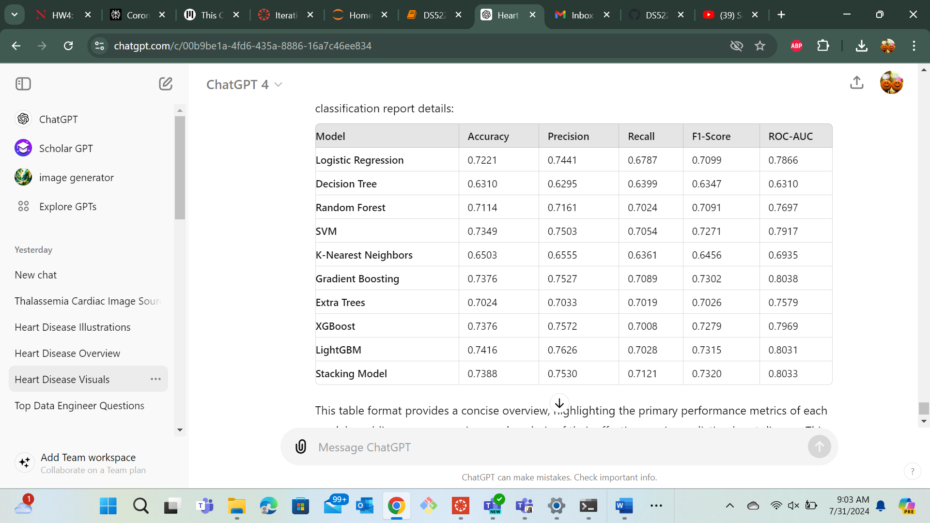
Outputs

Slide 17
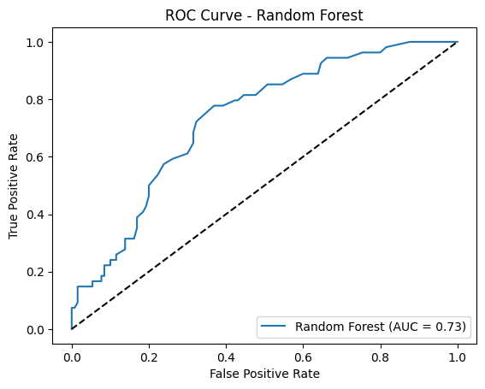
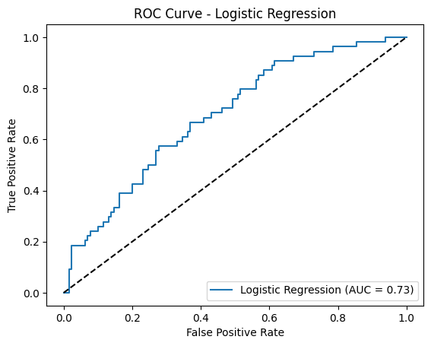
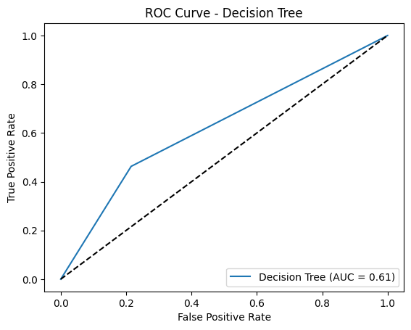
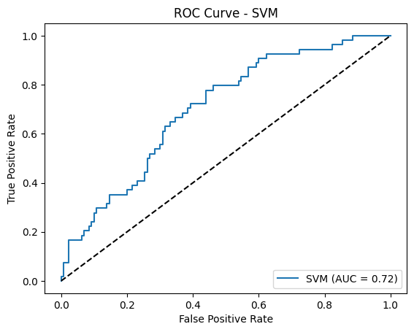
For Cardio Dataset

Slide 18
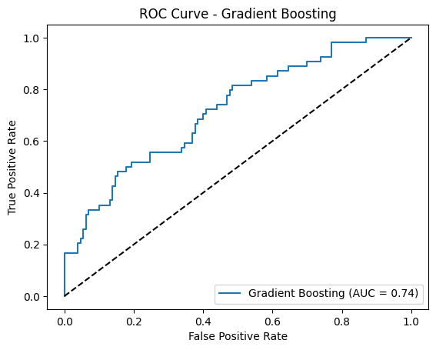
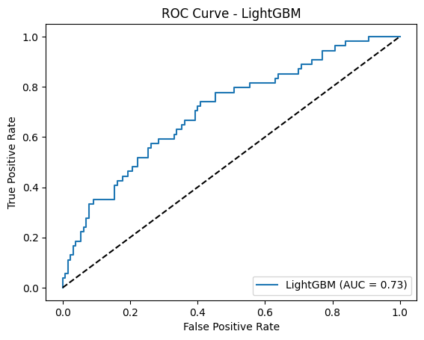
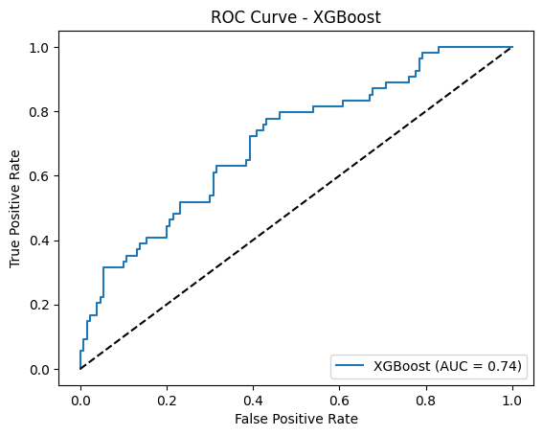

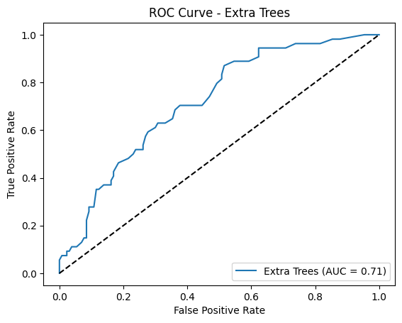

Slide 19
Conclusion for Cardio Dataset
Gradient Boosting and LightGBM achieved the highest ROC-AUC score (0.8038 and 0.8031 respectively), indicating their superior performance in distinguishing between the classes.
XGBoost and LightGBM also demonstrated high precision and F1-scores, making them reliable models for practical implementation.
While the SVM model showed good performance, its ROC-AUC (0.7917) was slightly lower than the top-performing models.
The Decision Tree model, despite its simplicity, had the lowest performance metrics, making it less suitable for this task.

Slide 20
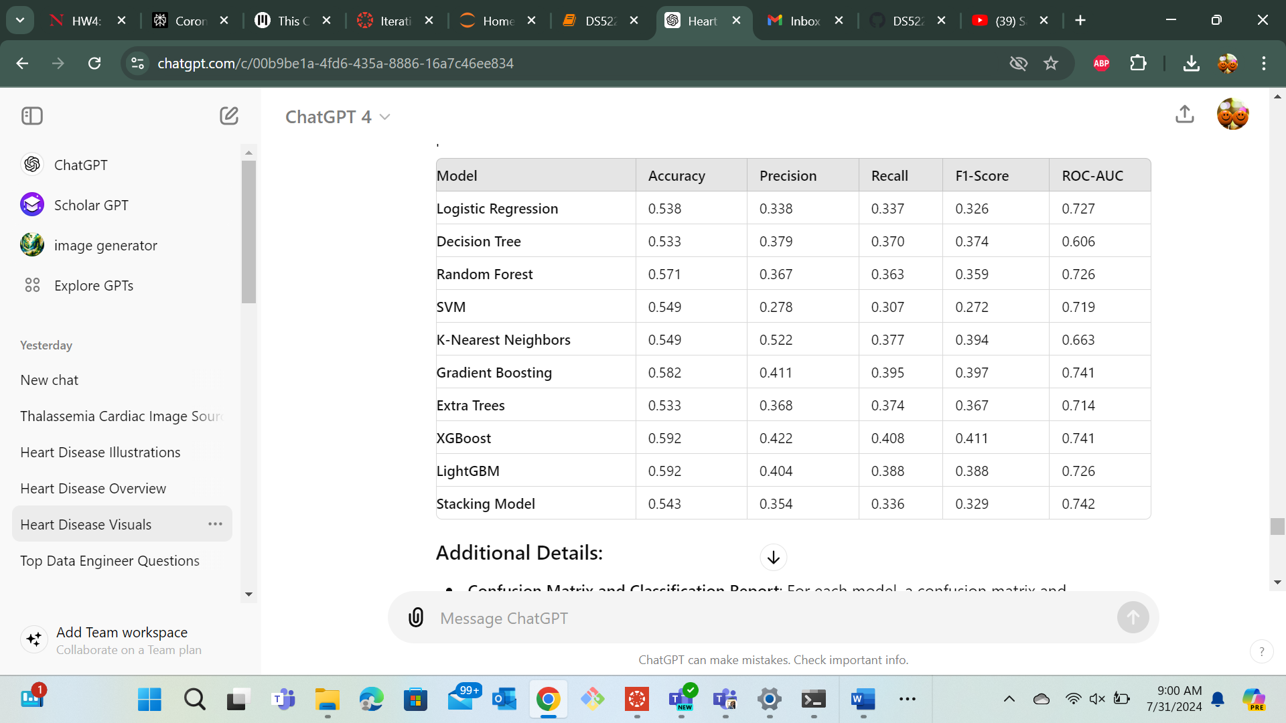

Slide 21
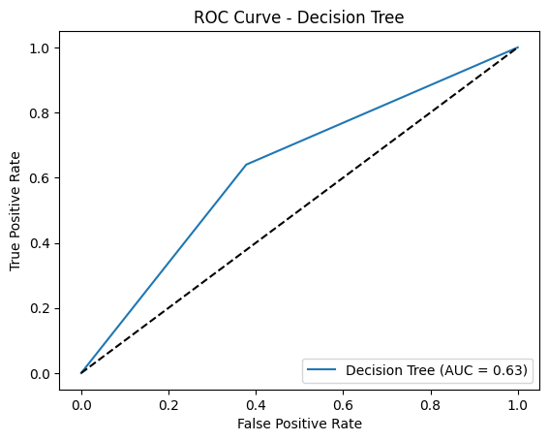
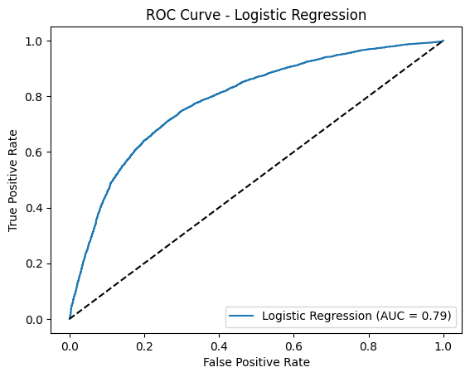
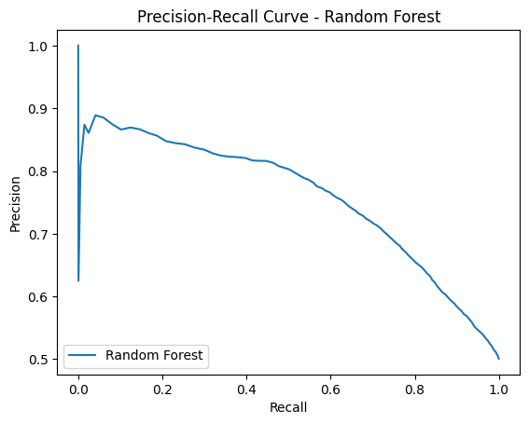
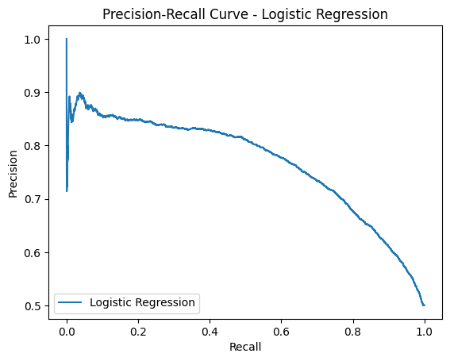
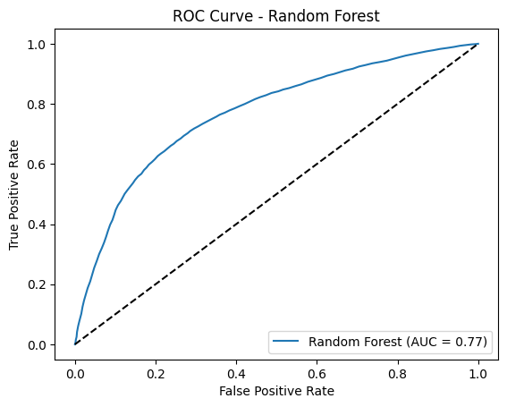
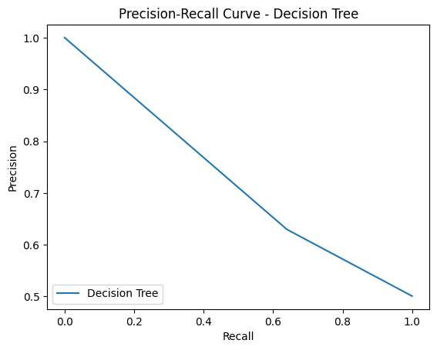

Slide 22
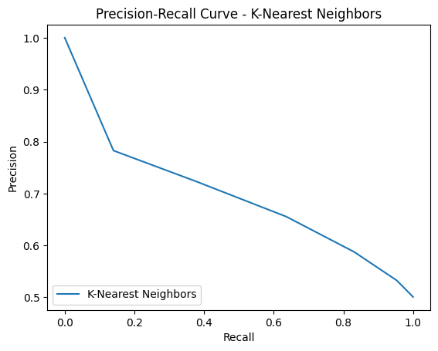
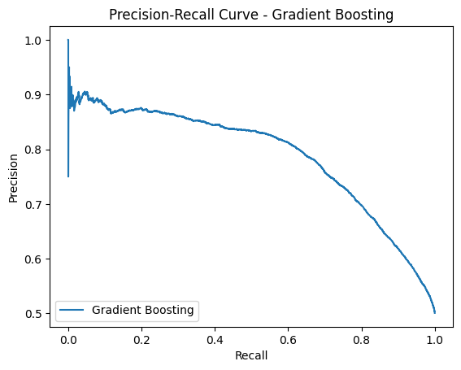
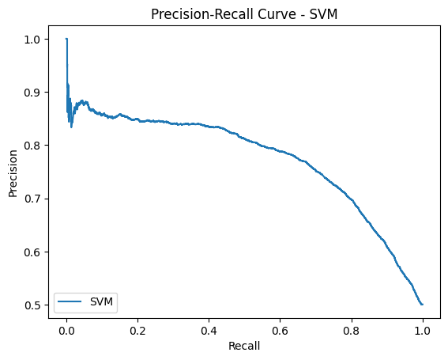

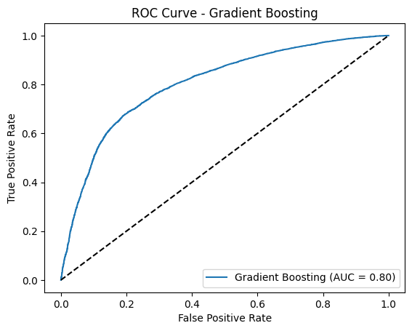
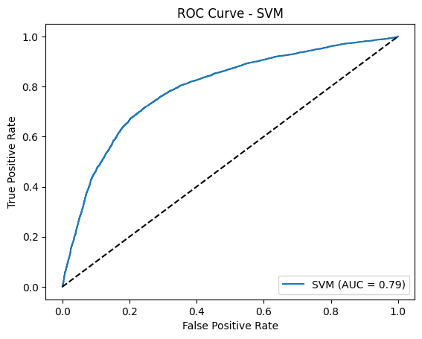

Slide 23
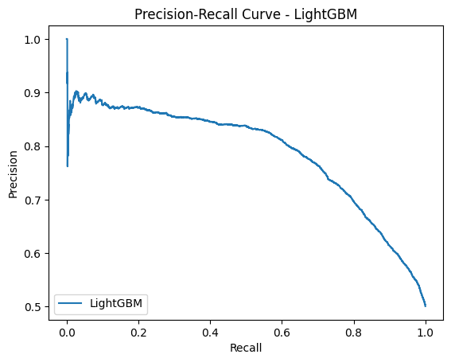
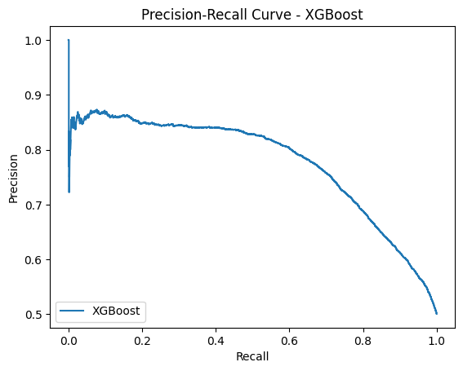
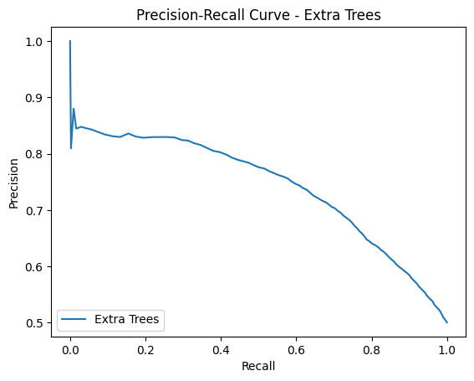
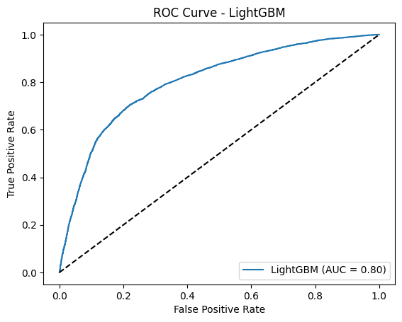
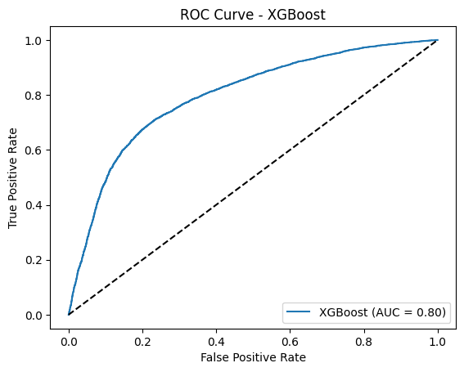
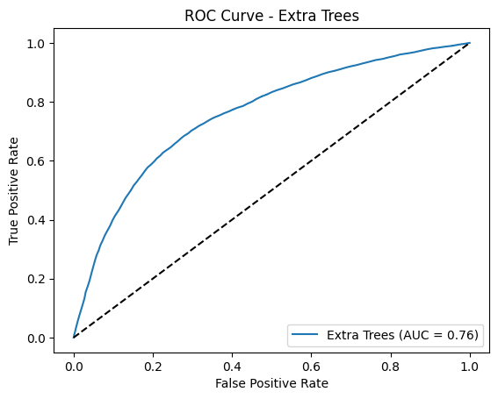

Slide 24
Conclusion for UCI Dataset
Best Model: Gradient Boosting stands out as the best model due to its highest accuracy and ROC-AUC scores across both evaluations.
Robust Alternatives: LightGBM and XGBoost also demonstrated strong performance and are good alternatives.
Model Selection: Depending on specific use cases, such as the need for higher precision or recall, different models may be preferred. However, Gradient Boosting provides a balanced and robust option for predicting heart disease in this dataset.

Slide 25
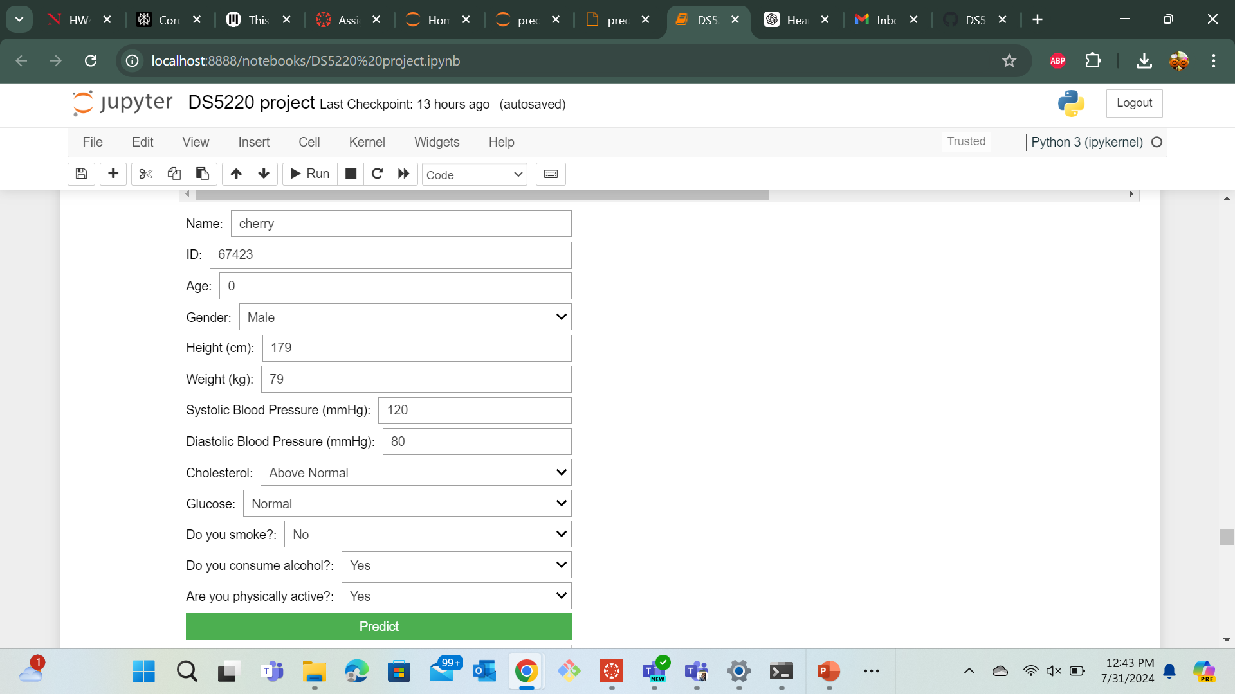
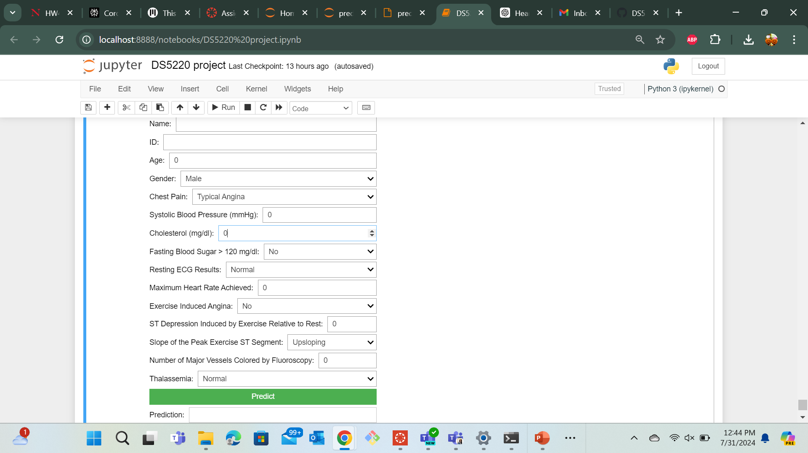
Predicting Diseases

Slide 26

Thank you

